Slide 1
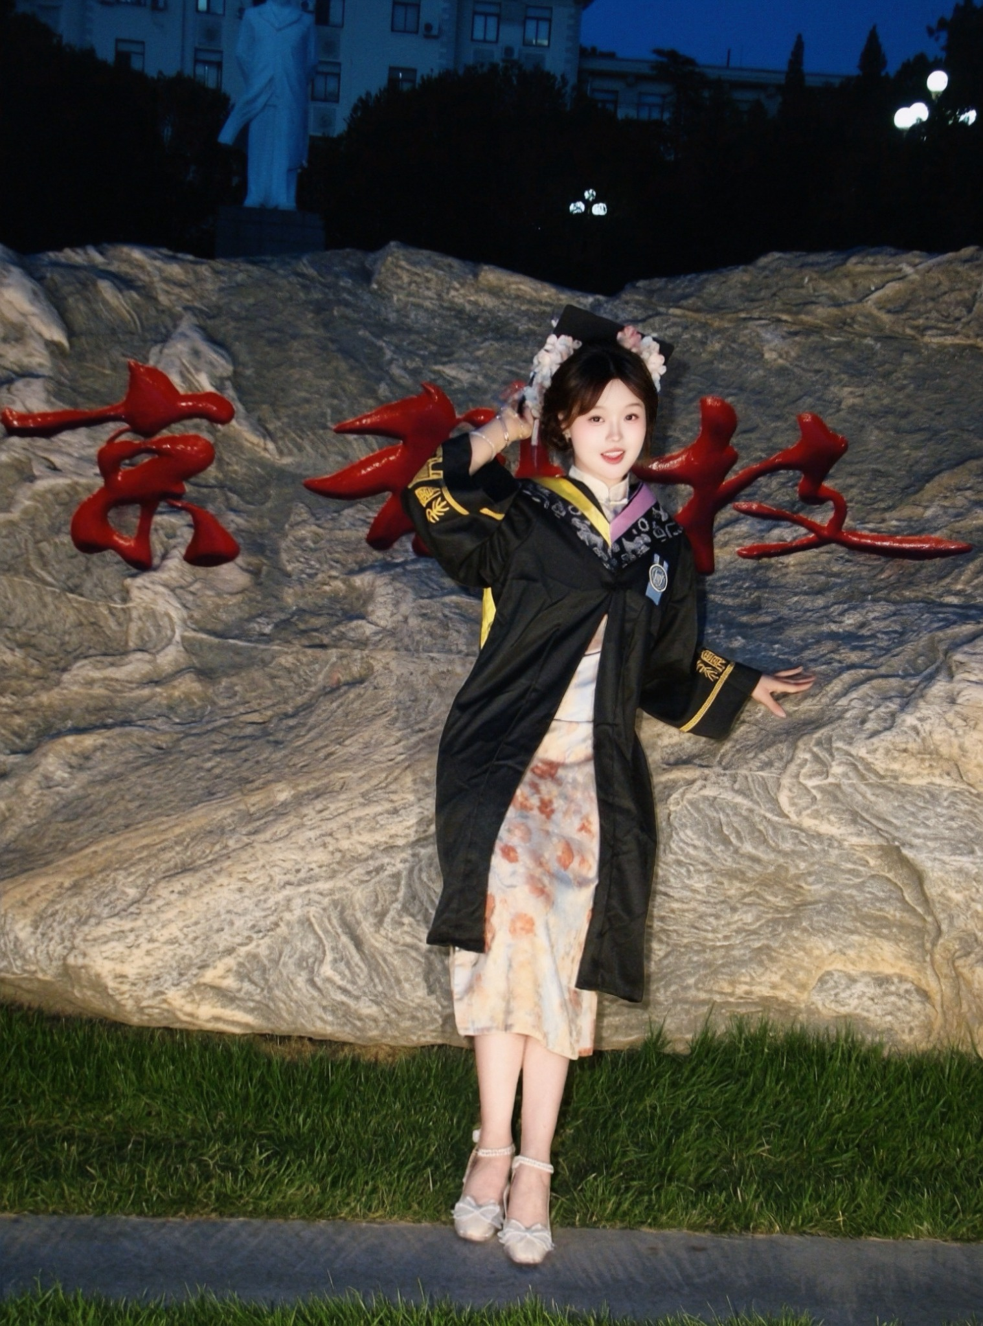

A PERSONAL
HISTORY
Xiwen Wang
Master’s Student · Applied and Public History
NUS-INSPIRED EDITORIAL
01

Slide 2
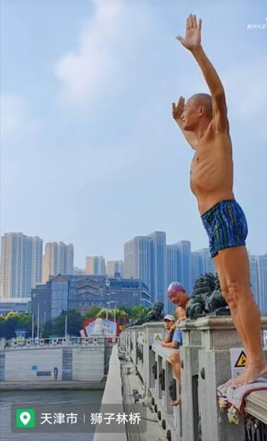
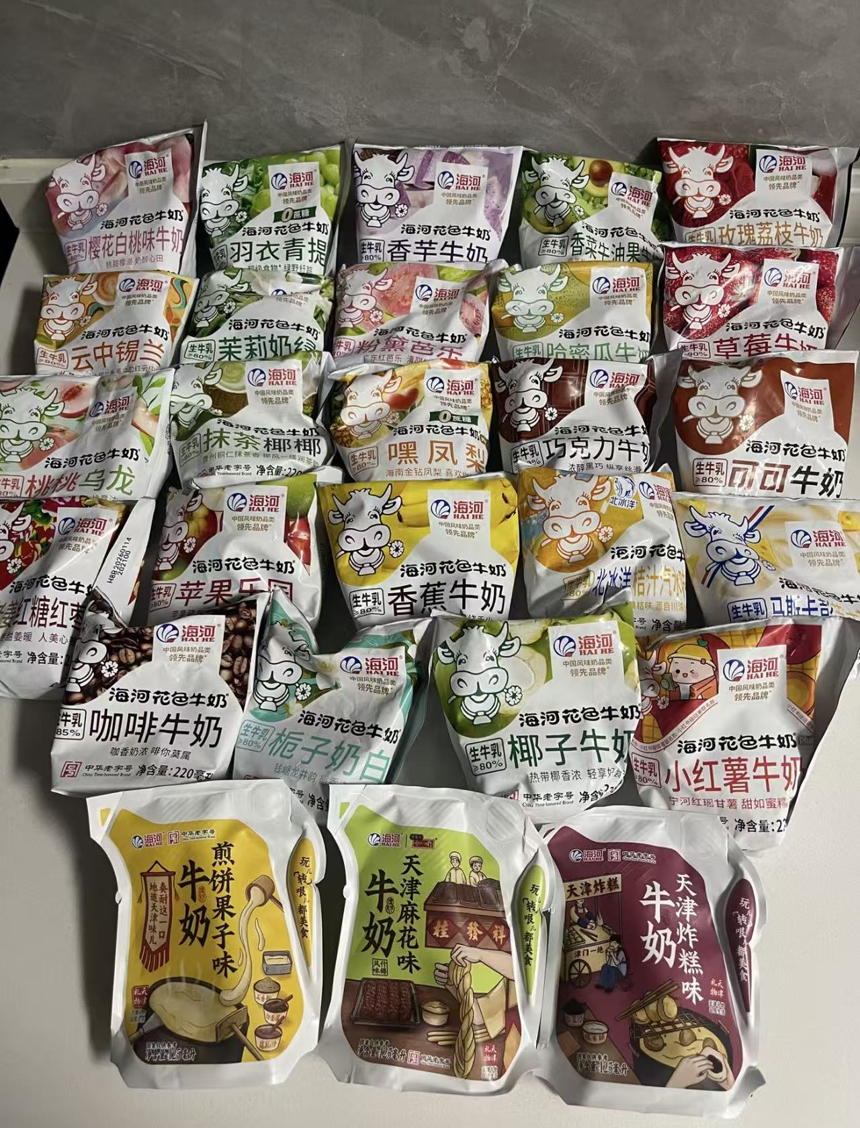
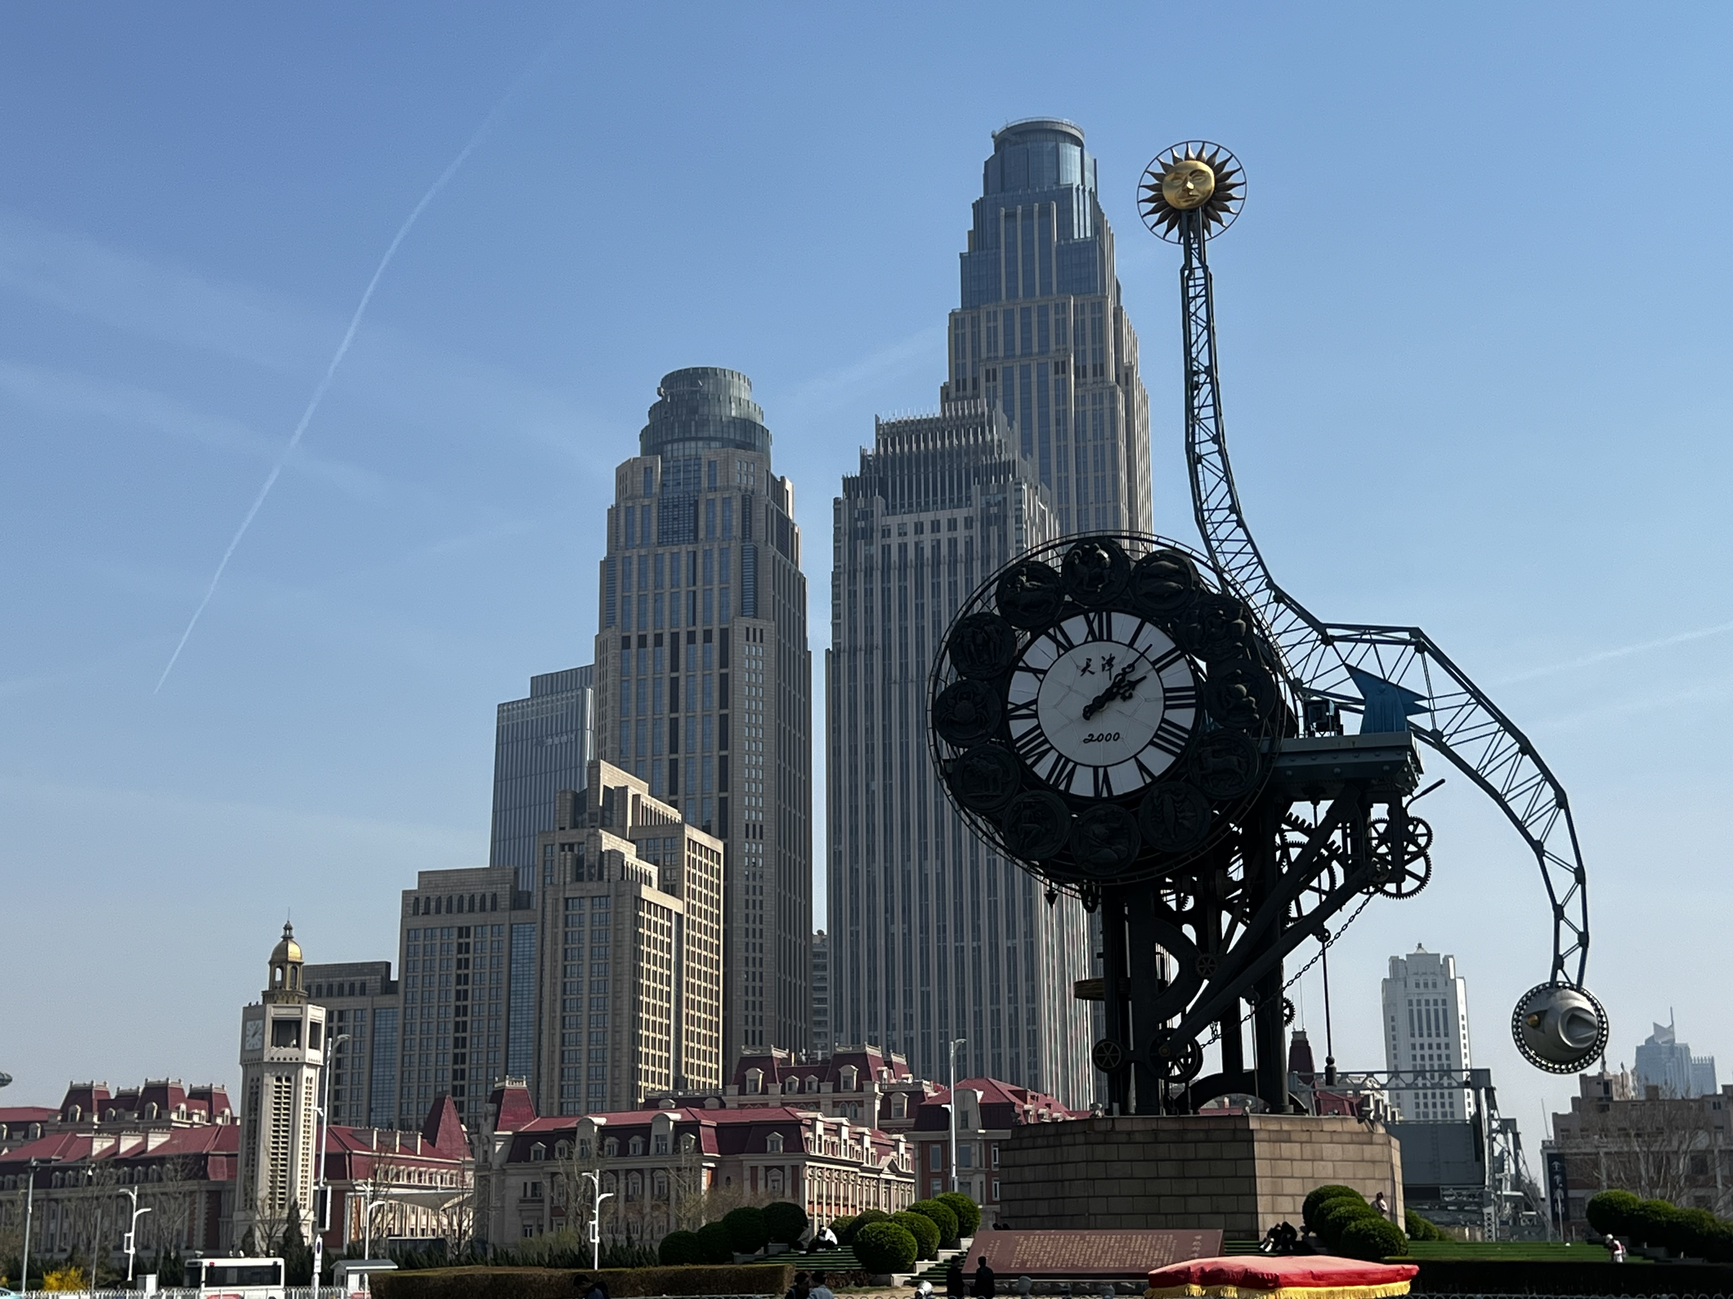
01 / WHERE I COME FROM
Tianjin
A city with history — and its own pace.
A city with history — and its own pace.
A relaxed rhythm, strong local character, and an everyday life that feels very much its own.
Replace the boxes with your own Tianjin photos.
XIwen Wang · Personal Introduction
02

Slide 3
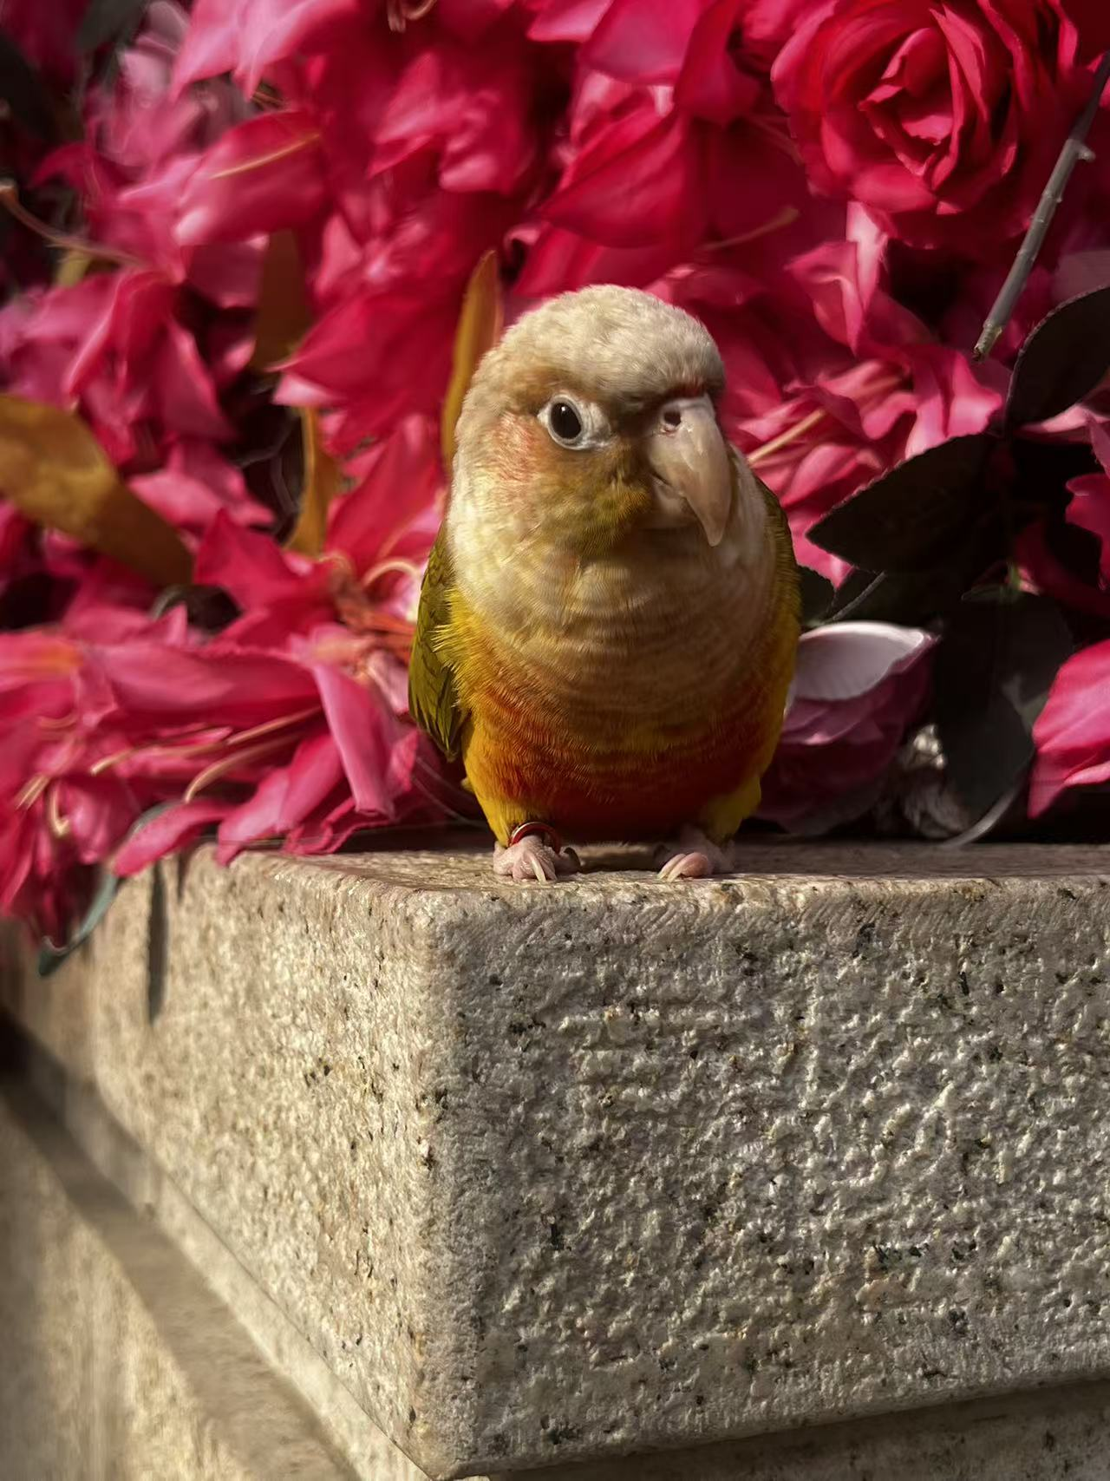
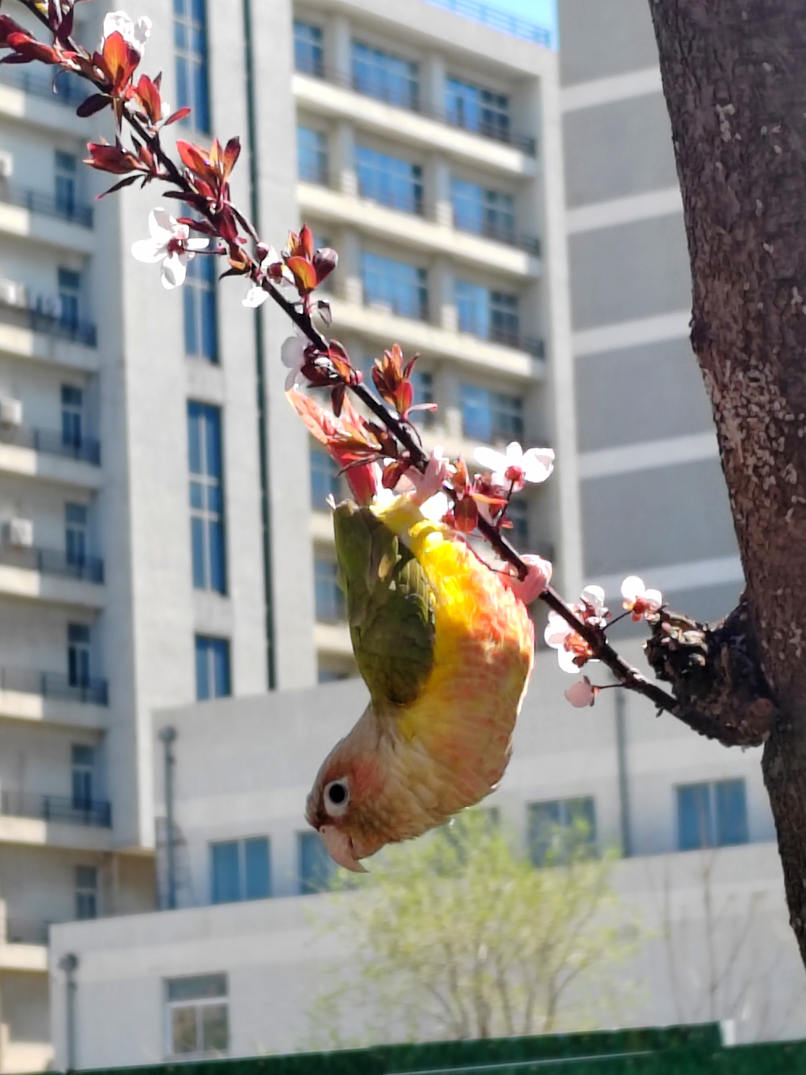
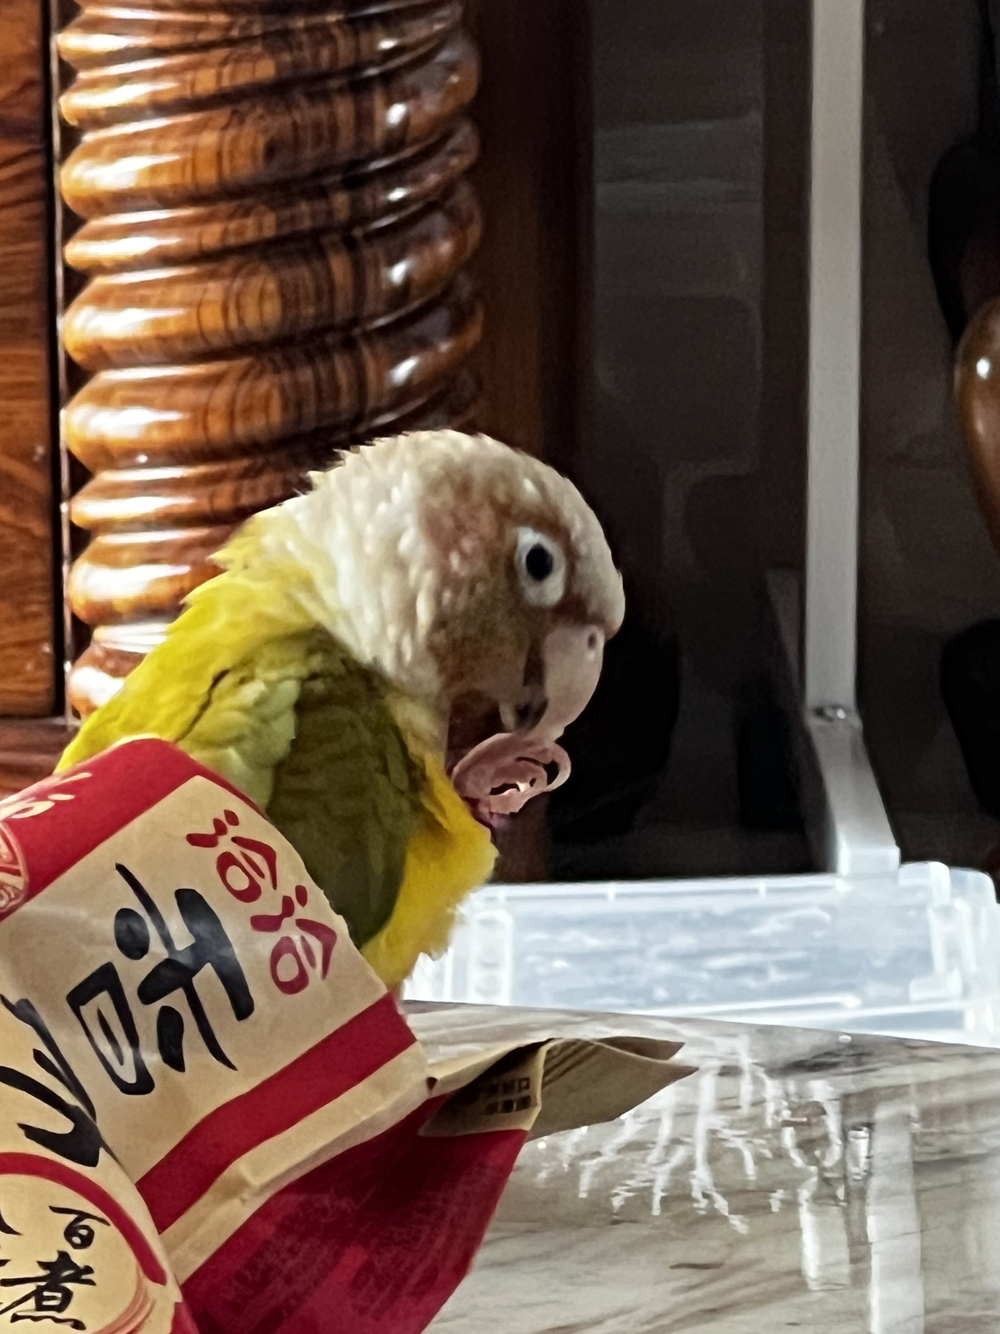
02 / A SMALL PART OF MY LIFE
Spinach
My little companion.
A parrot with a very
big personality.
Sometimes quiet. Sometimes very vocal.
Always part of my daily life.
XIwen Wang · Personal Introduction
03

Slide 4
03 / WHY HISTORY?
History is not only about
what happened.
People
Events
It is also about
why it happened.
Connections
Change
For me, history is like reading a complex story —
and then looking for the logic behind it.
XIwen Wang · Personal Introduction
04

Slide 5
04 / HOW THE FIELD IS CHANGING
History is changing, too.
Archives
Oral history
Data
Digital
methods
AI
Traditional sources meet new tools.
Documents, archives, statistics, maps, digital humanities, and emerging AI tools can all become part of historical research.
XIwen Wang · Personal Introduction
05

Slide 6
WHAT COMES NEXT?
PhD
A difficult goal —
but one worth preparing for.
I hope to continue studying questions
that genuinely interest me.
THANK YOU
06

